Slide 1
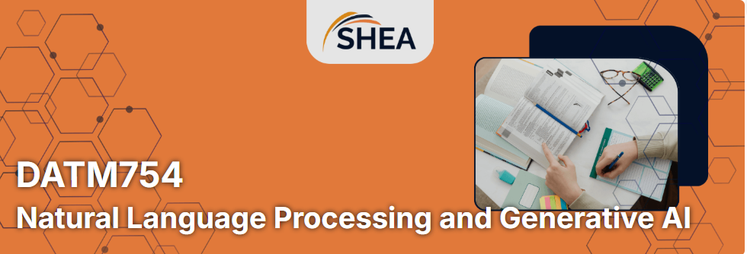
DATM754 Natural Language Processing and Generative Artificial Intelligence
Week 1: Introduction to NLP
Dr. Farshid Keivanian

Slide 2
Big View of This Unit
In this unit, you will learn how computers work with human language.
You will explore how AI systems:
read text,
clean messy language,
split text into useful parts,
find patterns,
classify text,
summarise information,
and support chatbot or Generative AI systems.

Slide 3
The main idea is simple:
Raw text is messy. NLP helps us turn messy language into useful data.
By the end of the unit, you should be able to design, build, and explain a practical NLP workflow.

Slide 4
What This Unit Expects From You
You are expected to:
attend and participate,
complete weekly practice,
write clean and simple code,
explain your own work,
connect theory to examples,
use ethical and responsible AI thinking,
prepare for viva questions,
submit reproducible notebooks.

Slide 5
A good student in this unit does not just “run code”.
A good student can explain:
What did I do? Why did I do it? What changed in the text? How could this affect a model later?

Slide 6
Why This Unit Matters for Jobs in Australia
NLP and Generative AI skills are useful in many Australian job areas, including:
data analyst,
AI/ML engineer,
junior data scientist,
business analyst,
chatbot developer,
automation consultant,
digital transformation analyst,
research assistant,
cybersecurity analyst using text logs,
customer analytics specialist.

Slide 7
Jobs and Skills Australia reports that Generative AI is more likely to support and improve human work rather than simply replace it, and it is changing skills needs across many occupations. SEEK job listings also show Australian demand for data science, machine learning, and LLM-related roles, including hybrid and government/public-sector roles.

Slide 8
This unit helps you build job-ready skills such as:
Python text processing,
data cleaning,
tokenisation,
vocabulary analysis,
feature preparation,
model evaluation,
explaining AI decisions,
communicating technical results,
ethical AI awareness.

Slide 9
Industry Insight: Where NLP Is Used
NLP is used in real workplaces for:
customer review analysis,
email classification,
chatbot support,
fraud detection from text,
resume screening,
legal document search,
medical note analysis,
social media monitoring,
sentiment analysis,
summarising large documents.

Slide 10
Example:
Question: A company receives 10,000 customer reviews. What can NLP do?
Answer: NLP can clean the text, count common words, find complaints, classify positive/negative reviews, and summarise key problems.

Slide 11
Big View of Week 1
Week 1 introduces the language of AI, NLP, and Generative AI.
You will understand:
what AI, ML, DL, NLP, and Generative AI mean,
how NLP fits inside AI,
what a basic NLP pipeline looks like,
why preprocessing is important,
why tokenisation is not always simple,
how Week 1 connects to Assessment 1.

Slide 12
Week 1 Learning Objectives
By the end of Week 1, you should be able to:
define NLP in simple words,
define Generative AI in simple words,
explain the NLP pipeline,
identify everyday NLP examples,
run a small tokenisation demo,
explain why raw text needs preprocessing.

Slide 13
Concept 1: What Is NLP?
Simple meaning:
NLP means teaching computers to work with human language.
Examples:
Google Search understands your query.
Gmail detects spam.
Google Translate translates sentences.
ChatGPT generates text.
Siri or Alexa understands voice commands.

Slide 14
Discussion Question
Q: Is spell check an NLP system?
A: Yes. It reads text, detects language patterns, and suggests corrections.
Q: Is a calculator an NLP system?
A: No, not normally. A calculator works with numbers, not human language.

Slide 15
Concept 2: What Is Generative AI?
Simple meaning:
Generative AI creates new content.
It can create:
text,
code,
images,
summaries,
answers,
chatbot responses.

Slide 16
Discussion Question
Q: Is ChatGPT an example of Generative AI?
A: Yes. It generates new text based on your prompt.
Q: Is a spam filter Generative AI?
A: Not usually. A spam filter normally classifies text instead of creating new text.

Slide 17
Concept 3: AI, Machine Learning, Deep Learning, NLP
Simple relationship:
AI is the big field.
Machine Learning is one part of AI.
Deep Learning is one part of Machine Learning.
NLP is focused on language.
Generative AI can use NLP to generate language.

Slide 18
Discussion Question
Q: Where does NLP fit?
A: NLP is an AI area that focuses on language.
Q: Does every NLP system use deep learning?
A: No. Some NLP systems use simple rules or classical machine learning.

Slide 19
Concept 4: The NLP Pipeline
A common NLP pipeline is:
Ingest → Preprocess → Represent → Model → Evaluate
Simple meaning:
Ingest: collect text.
Preprocess: clean and prepare text.
Represent: turn text into numbers/features.
Model: train or use an algorithm.
Evaluate: check how well it works.

Slide 20
Discussion Question
Q: Which part is most connected to Assessment 1?
A: Preprocess. Assessment 1 is about preparing raw text for later modelling.

Slide 21
Concept 5: Why Text Preprocessing Matters
Raw text is messy.
Example raw text:
“I LOVE this app!!! 😊 Visit https://app.com”
A computer needs clear rules for:
lowercase or not,
punctuation,
emojis,
URLs,
contractions,
stopwords,
spelling,
repeated words.

Slide 22
Discussion Question
Q: Should we always remove emojis?
A: No. If we analyse sentiment, emojis may be useful. If we analyse formal reports, emojis may not matter.

Slide 23
Concept 6: Tokenisation
Tokenisation means splitting text into smaller pieces.
Example:
“It’s amazing!”
Possible tokens:
“It”, “’s”, “amazing”, “!”
Discussion Question
Q: Why is tokenisation not always easy?
A: Because URLs, emojis, hyphenated words, contractions, and languages without spaces can be difficult to split correctly.

Slide 24
Concept 7: Corpus, Tokens, and Vocabulary
A corpus is a collection of texts.
A token is one item after splitting text.
A vocabulary is the list of unique tokens.
Example:
Text: “The dog chased the cat.”
Tokens: The, dog, chased, the, cat
Vocabulary: The, dog, chased, cat

Slide 25
Discussion Question
Q: How many tokens are there?
A: 5.
Q: How many unique vocabulary items are there?
A: 4, if “The” and “the” are treated as the same after lowercasing.

Slide 26
Week 1 Hands-On: Build Your First Simple Language Bot
Goal: Create a simple Telegram bot that receives human text and sends a response. Then discuss what would need to change for the bot to actually use NLP or Generative AI.
After you run the code, answer these questions:
Question 1: What happens when you type Hello?
Question 2: Does this bot understand what “Hello” means?
Question 3: Is tokenisation happening in our code?
Question 4: How could we make this an NLP application?
Question 5: How could we make it a Generative AI chatbot?

Slide 27
Week 1 Hands-On: Build Your First Simple Language Bot
Question 1: What happens when you type Hello?
The bot receives the text and echoes it back.
Question 2: Does this bot understand what “Hello” means?
No. It follows rules in our Python code.
Question 3: Is tokenisation happening in our code?
No. We are currently treating the user's message as text and returning it without building an NLP preprocessing pipeline.

Slide 28
Week 1 Hands-On: Build Your First Simple Language Bot
Question 4: How could we make this an NLP application?
We could add cleaning, tokenisation, sentiment analysis, intent classification, or another NLP task.
Question 5: How could we make it a Generative AI chatbot?
Instead of simply echoing message.text, we could send the user's message to an LLM and return the generated response.
Assessment 1 connection explicit:
Telegram message → raw text → clean → tokenise → normalise → analyse
Assessment 1 focuses on the middle part. You are learning how to prepare raw language before later NLP modelling.

Slide 29
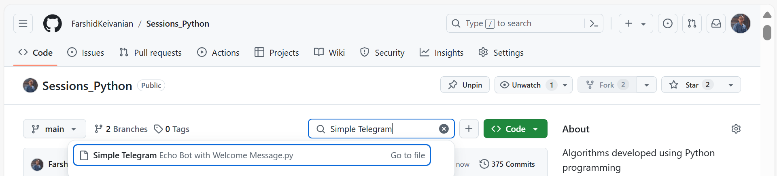
Week 1 Hands-On: Build Your First Simple Language Bot
This Python script implements a simple Telegram bot using the telebot library. The bot responds with a welcome message for specific commands (/start and /hello) and echoes back any text messages sent by users.

Slide 30
Week 1 Hands-On: Build Your First Simple Language Bot
pip install pyTelegramBotAPI
pip install requests
Install the Required Library: Install the pyTelegramBotAPI library using pip:

Slide 31
Steps to Get Started
Create a Telegram Bot:
  Open Telegram and search for @BotFather
  Start a chat with BotFather and use the command /newbot to create a bot.
  Follow this instruction and get your bot's API token:
  Send the command /newbot to BotFather.
  BotFather will ask you for:
    A name for your bot (e.g., "MyTestBot").
    A username for your bot (e.g., "MyTestBot123"). The username must end with "bot".

Slide 32
Week 1 Hands-On: Build Your First Simple Language Bot
Receive the Token
Once you've chosen a name and username, BotFather will generate and send you a message with your bot's API token.
The message will look something like this:
Done! Congratulations on your new bot. You will find it at t.me/FarshidKeivanian.
You can now add a description, about section, and profile picture for your bot. See /help for a list of commands.
Use this token to access the HTTP API:
……..

Slide 33
Week 1 Hands-On: Build Your First Simple Language Bot
Copy the Token
Copy the token (e.g., ….:ABCDEFGHIJKLMNOPQRSTUVWXYZ12345678) to use it in the Python code.

Slide 34
import telebot
# Replace with your bot's API token
API_TOKEN = 'Replace with your bot’s API token'
# Initialize the bot
bot = telebot.TeleBot(API_TOKEN)
# Command to handle the '/start' or '/hello' message
@bot.message_handler(commands=['start', 'hello'])
def send_welcome(message):
bot.reply_to(message, "Welcome to my bot, Farshidkeivanian!")
# Command to handle text messages
@bot.message_handler(func=lambda message: True)
def echo_all(message):
bot.reply_to(message, f"You said: {message.text}")
# Poll the server for new messages
print("Bot is running... Press Ctrl+C to stop.")
bot.polling()
Paste your API token (e.g., ….:ABCDEFGHIJKLMNOPQRSTUVWXYZ12345678) in here!
This code is a simple Telegram bot implemented using the telebot library. It initializes the bot with an API token and defines two functionalities:
Welcome Message: Responds with a greeting when the /start or /hello command is received.

Slide 35
import telebot
# Replace with your bot's API token
API_TOKEN = 'Replace with your bot’s API token'
# Initialize the bot
bot = telebot.TeleBot(API_TOKEN)
# Command to handle the '/start' or '/hello' message
@bot.message_handler(commands=['start', 'hello'])
def send_welcome(message):
bot.reply_to(message, "Welcome to my bot, Farshidkeivanian!")
# Command to handle text messages
@bot.message_handler(func=lambda message: True)
def echo_all(message):
bot.reply_to(message, f"You said: {message.text}")
# Poll the server for new messages
print("Bot is running... Press Ctrl+C to stop.")
bot.polling()
Echo Functionality: Replies to any text message by echoing it back to the sender.
The bot continuously polls Telegram servers to handle incoming messages and run its defined actions.

Slide 36
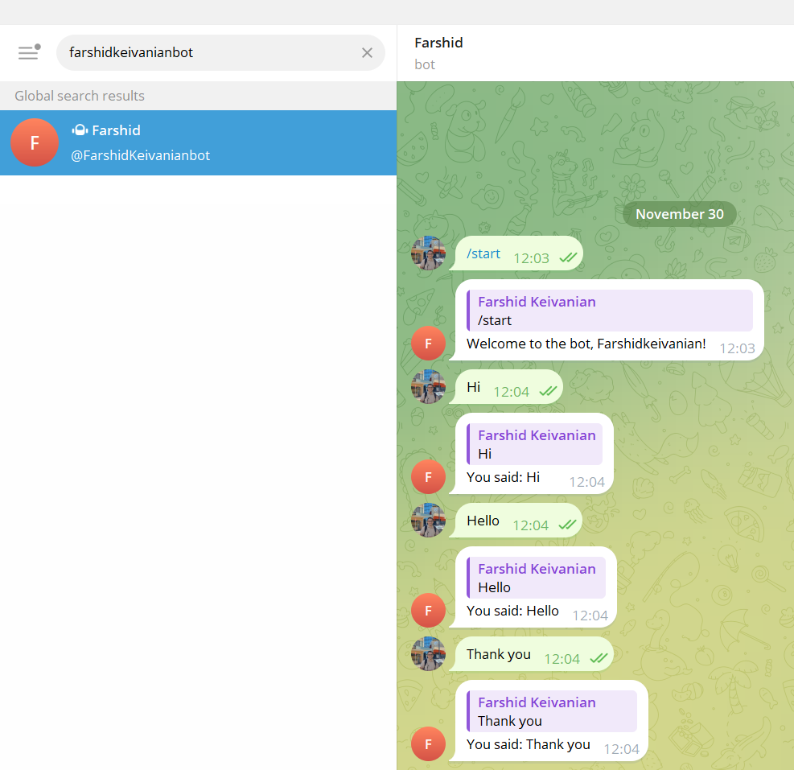
Week 1 Hands-On: Build Your First Simple Language Bot
It replies to any text message by echoing it back to the sender.

Slide 37
Week 1 Hands-On: Build Your First Simple Language Bot
How It Works:
Start the Bot:
  Run the Python script.
  Your bot will start polling Telegram for new messages.
Interact with the Bot:
  Open Telegram and search for your bot using the username you set in BotFather.
  Send /start or /hello to see the bot respond.
  Any other text you send will be echoed back.

Slide 38
Week 1 Hands-On: Build Your First Simple Language Bot
If someone knows your Telegram username, they can:
Search for You on Telegram: Your username makes you searchable on Telegram. Anyone who enters your username in the search bar can find your profile and initiate a chat.
Send Messages: People can send you messages directly, even if they don't have your phone number. However, they won’t see your phone number unless you explicitly share it with them.

Slide 39
Week 1 Hands-On: Build Your First Simple Language Bot
How to Control Who Can Message You
Telegram provides privacy settings to manage this:
Restrict Who Can Message You:
  Go to Settings → Privacy and Security → Who Can Find Me By My Number? or similar settings.
  Adjust settings for messages, calls, and group invitations. For example, you can limit who can contact you by choosing options like "My Contacts" or "Nobody."

Slide 40
Week 1 Hands-On: Build Your First Simple Language Bot
Block Specific Users:
  If someone contacts you and you don’t want to communicate with them, open their chat, tap their name or profile, and select Block User.
Enable Two-Step Verification:
  Add an additional password to your Telegram account for enhanced security: Settings → Privacy and Security → Two-Step Verification.

Slide 41
Week 1 Hands-On: Build Your First Simple Language Bot
If You Don't Want to Be Contacted by Everyone:
  Avoid sharing your username publicly or with untrusted individuals.
  You can remove your username altogether in Settings → Edit Profile, which will make it impossible for others to find you by username.

Slide 42
Week 1 Hands-On Activity: Extend Your Telegram Bot
Class Activity: Handle Additional Commands
Students can modify the code to handle more commands, such as providing bot information or fun responses. Here's an example:
Activity Goal:
Review commands (/info, /help) added to the bot for additional functionalities.
Run and explain its functionalities

Slide 43
import telebot
# Replace with your bot's API token
API_TOKEN = 'Replace with your bot's API token'
# Initialize the bot
bot = telebot.TeleBot(API_TOKEN)
# Command to handle the '/start' or '/hello' message
@bot.message_handler(commands=['start', 'hello'])
def send_welcome(message):
bot.reply_to(message, "Welcome to my bot, Farshidkeivanian!")
# Command to handle the '/info' message
@bot.message_handler(commands=['info'])
def send_info(message):
bot.reply_to(message, "This is a simple echo bot created using Python's telebot library.")
# Command to handle the '/help' message
@bot.message_handler(commands=['help'])
def send_help(message):
bot.reply_to(message, "Here are some commands you can try:\n/start or /hello - Welcome message\n/info - Information about the bot\n/help - List of commands")
Task for Students:
Understand the Changes: Review and explain how new commands like /info and /help are added.

Slide 44
# Command to handle text messages
@bot.message_handler(func=lambda message: True)
def echo_all(message):
bot.reply_to(message, f"You said: {message.text}")
# Poll the server for new messages
print("Bot is running... Press Ctrl+C to stop.")
bot.polling()
Week 1 Hands-On Activity: Extend Your Telegram Bot
Implement a New Command: Add a /joke command that sends a random joke or any fun response.
Test the Bot: Run the bot and test the new commands in Telegram.
This activity encourages you to explore the library and understand how to expand the bot's functionality.

Slide 45
Assessment 1 Clarification
Assessment 1: Text Pre-processing Pipeline + Viva
Assessment 1 is worth 30%.
You must submit:
A notebook: .ipynb or .py + HTML export
A rationale: 500–600 words, PDF
A viva: 2–3 questions
The viva is important. It is worth 40% of Assessment 1, meaning 12 marks out of the 30 assessment marks.

Slide 46
What Assessment 1 Is Really Asking You To Do
You need to show that you can:
choose a small text corpus,
clean the text,
tokenise the text,
normalise the text,
inspect the vocabulary,
show before/after examples,
document your steps,
explain your choices clearly.
The goal is not to build a big model.
The goal is: Can you turn messy text into model-ready text and explain your choices?

Slide 47
Step-by-Step Guideline for Assessment 1
Step 1: Choose a Small Corpus
Choose a small set of text documents.
Examples:
20 product reviews,
20 movie reviews,
20 news headlines,
20 support messages,
20 public social media-style comments,
a small LMS-provided dataset.

Slide 48
Similar Example
Q: Can I use 10,000 documents?
A: You can, but it may be too much for A1. A small corpus is better because you need to explain the pipeline clearly.

Slide 49
Step 2: Add Reproducibility Notes
At the top of your notebook, write:
Python version,
library versions,
random seed,
how to run the notebook,
file path instructions.

Slide 50
Example:
# Python 3.11
# Libraries: nltk, pandas, sklearn
# Random seed: 42
# Run all cells from top to bottom
Discussion Question
Q: Why do we need reproducibility notes?
A: So another person can run your notebook and get the same result.

Slide 51
Step 3: Write Pipeline Functions
Use simple functions such as:
def clean(text):
return text
def tokenise(text):
return tokens
def normalise(tokens):
return normalised_tokens
Your pipeline should run end-to-end.

Slide 52
Discussion Question
Q: Why are functions better than random code cells?
A: Functions make your work easier to test, repeat, and explain.

Slide 53
Step 4: Clean the Text
Cleaning may include:
removing extra spaces,
handling URLs,
handling punctuation,
fixing inconsistent case,
removing unwanted symbols.

Slide 54
Similar Example
Raw text:
“WOW!!! This product is GREAT!!! Visit https://shop.com”
Cleaned text may become:
“wow this product is great visit https://shop.com”
But be careful: removing too much can remove useful meaning.
Discussion Question
Q: Should I remove URLs?
A: It depends. If URLs are not useful, remove them. If links show source or behaviour, keep or replace them with a token like <URL>.

Slide 55
Step 5: Tokenise the Text
Choose a tokenisation tool.
Examples:
NLTK tokenizer,
spaCy tokenizer,
simple split for very basic text.
Show at least one edge case.

Slide 56
Edge cases:
URL,
emoji,
hyphenated word,
contraction,
punctuation,
email address.
Similar Example
Text: “Email me at test@email.com — it’s urgent!”
Possible tokens: Email, me, at, test@email.com, —, it, ’s, urgent, !

Slide 57
Discussion Question
Q: Why should I show an edge case?
A: It proves you tested your tokenizer on real messy language.

Slide 58
Step 6: Choose One Normalisation Policy
Choose lemmatisation or stemming, not both as your main policy.
Stemming example:
studies → studi
Lemmatisation example:
studies → study
better → good

Slide 59
Discussion Question
Q: Which one is easier to explain?
A: Lemmatisation is often easier to explain because it keeps real dictionary-like words.
Q: Is stemming wrong?
A: No. It can be useful, but it may produce less readable word forms.

Slide 60
Step 7: Build a Vocabulary Summary
Report:
vocabulary size,
top 5 tokens,
stopword policy,
rare-token rule.
Example:
Vocabulary size: 850
Top tokens: data, service, app, customer, error
Rare-token rule: remove tokens that occur only once
Stopword policy: removed common English stopwords

Slide 61
Discussion Question
Q: Why remove rare tokens?
A: Rare tokens can make the vocabulary very large and sparse.

Slide 62
Step 8: Show Before/After Examples
Include 3–5 examples.
Example:
Raw text | After preprocessing
“I’m LOVING this app!!! 😊” | i, am, love, app, 😊
“Battery-life is poor.” | battery-life, be, poor
“Visit https://x.com now” | visit, <URL>, now

Slide 63
Discussion Question
Q: Why are before/after examples important?
A: They show exactly what your pipeline changes.

Slide 64
Step 9: Write the Rationale
Your rationale is 500–600 words.
It should answer:
What corpus did you use?
What cleaning choices did you make?
What tokenizer did you use?
Did you use lemmatisation or stemming?
What happened to the vocabulary?
How will this help later models such as Naive Bayes or Logistic Regression?
What are the limitations?

Slide 65
Simple Rationale Sentence Starters
“I selected this corpus because…”
“I used this tokenizer because…”
“I chose lemmatisation instead of stemming because…”
“This preprocessing choice may help later models by…”
“One limitation of my pipeline is…”

Slide 66
Assessment 1 Viva Preparation
Prepare answers for these five areas:
Tokenisation edge case
Lemmatisation vs stemming
Vocabulary statistics
Ambiguity
Reproducibility

Slide 67
Viva Practice Question: Tokenisation
Q: Show one tokenisation edge case from your corpus. Why is your tokenizer suitable?
Sample Answer:
In my corpus, I had the sentence “Great service 😊 at https://shop.com”. My tokenizer kept the emoji and URL as separate tokens. This is useful because the emoji may show sentiment, and the URL may show source information. A simple space-split tokenizer may not handle these correctly.

Slide 68
Viva Practice Question 2: Normalisation
Q: Did you use lemmatisation or stemming? Why?
Sample Answer:
I used lemmatisation because it keeps meaningful word forms. For example, “studies” becomes “study”, and “better” becomes “good”. This makes the vocabulary smaller while keeping the meaning easier to understand. This can help later models use more consistent features.

Slide 69
Viva Practice Question 3: Vocabulary
Q: What are three vocabulary numbers from your corpus?
Sample Answer:
My vocabulary size was 920 unique tokens. The top tokens were “service”, “customer”, “app”, “data”, and “issue”. I removed tokens that appeared only once because they added noise and increased sparsity.

Slide 70
Viva Practice Question 4: Ambiguity
Q: Give one ambiguity example from your corpus.
Sample Answer:
The word “charge” is ambiguous. It can mean battery charge or payment charge. My preprocessing does not fully solve this ambiguity, but consistent tokenisation and lemmatisation prepare the text for later models that can use context.

Slide 71
Viva Practice Question 5: Reproducibility
Q: What steps make your notebook reproducible?
Sample Answer:
I listed Python and library versions at the top. I used a fixed random seed. I organised the pipeline using functions such as clean(), tokenise(), and normalise(). I also used relative file paths and included clear run instructions.

Slide 72
Week 1 Case Study: Customer Review Analysis
A company has these reviews:
1. "Love the battery life!"
2. "Battery drains fast."
3. "Great camera, but poor battery."
Question
What can we learn before building a model?
We can count frequent words. “Battery” appears often, so it may be an important topic. Words like “love”, “great”, “poor”, and “fast” may help with sentiment. This shows why preprocessing is the first step before modelling.

Slide 73
How Week 1 Connects to Assessment 1
Week 1 helps you understand:
what NLP is,
why raw text is messy,
why tokenisation matters,
why corpus and vocabulary are important,
why preprocessing affects later modelling.
Assessment 1 asks you to apply these ideas in your own small project.

Slide 74
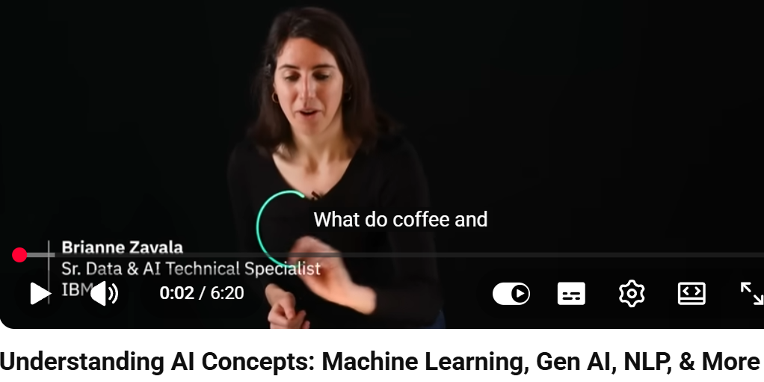
Key Lessons from Video 1: AI, ML, Deep Learning, NLP, Generative AI
Key Lessons
AI has many terms, and we need to understand them clearly.
Machine learning means learning patterns from data.
Deep learning uses neural networks and can handle large data.
NLP helps computers understand and generate language.
Data is the fuel for AI.
Bias in data can affect results.
Training, validation, and testing are like practice, midterm, and final
exam.
Generative AI creates new text, images, or code.
https://www.youtube.com/watch?v=w__y7508704

Slide 75
Explainable AI helps people understand AI decisions.
Responsible use of AI is important.
Discussion Question
Q: Why is data called the “fuel” of AI?
A: Because AI systems learn from data. If the data is poor, biased, or messy, the result may also be poor.
Q: Why does explainable AI matter?
A: Because people need to understand why an AI system
made a decision, especially in important areas like health,
finance, or education.
https://www.youtube.com/watch?v=w__y7508704

Slide 76
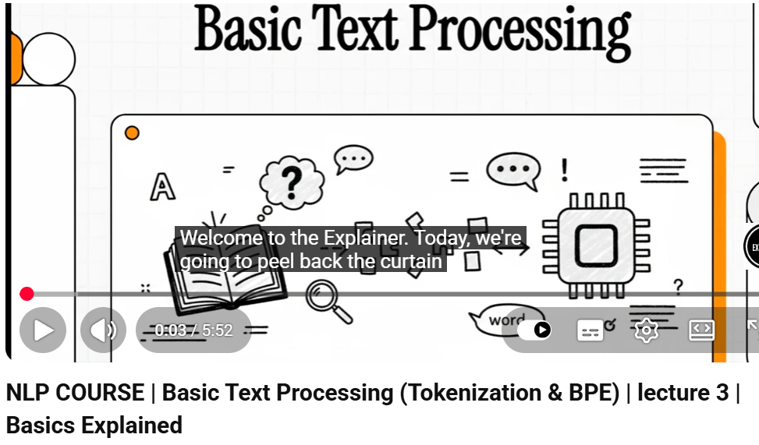
Key Lessons from Video 2: Words, Tokens, Corpus, and BPE
Key Lessons
Counting words is not always simple.
Tokens are total items in the text.
Types are unique items.
A corpus is a large collection of text.
Simple splitting by spaces can fail.
URLs, prices, emails, and punctuation can cause problems.
Some languages do not use spaces between words.
Subword tokenisation breaks words into smaller useful parts.
https://www.youtube.com/watch?v=PPJzuVzbmMg

Slide 77
Byte Pair Encoding builds tokens from common character patterns.
Modern NLP needs smart tokenisation.
Discussion Question
Q: Why can simple space-splitting fail?
A: Because real text contains URLs, emails, punctuation, emojis, contractions, and languages without spaces.
Q: Why is subword tokenisation useful?
A: It can handle new words, spelling variations, slang, and
rare words by breaking them into smaller parts.
https://www.youtube.com/watch?v=PPJzuVzbmMg

Slide 78
Frequently Asked Questions
Q1. Do I need to build a machine learning model in Assessment 1?
A: No. Assessment 1 is about preprocessing, not model building.
Q2. Can I use ChatGPT to write my assignment?
A: No. You must write your own code and rationale. You may use tools for learning, but your submission must be your own work.
Q3. Can I use an external dataset?
A: Yes, but you must cite it and mention licensing or attribution.
Q4. Should I use stemming and lemmatisation together?
A: No. Choose one main policy and justify it.

Slide 79
Q5. How many before/after examples do I need?
A: Use 3–5 clear examples.
Q6. What should be in the top cell of my notebook?
A: Environment details, library versions, random seed, data path, and run instructions.
Q7. What if my tokenizer gives different results from another student’s tokenizer?
A: That is okay. You need to explain why your tokenizer is suitable for your corpus.
Q8. What is the most important part of the viva?
A: Explaining your own choices clearly with examples from your own work.

Slide 80
Q9. Can I use a very large corpus?
A: It is better to use a small, clear corpus for Assessment 1. The focus is quality and explanation.
Q10. What is a strong Assessment 1 submission?
A: A strong submission runs end-to-end, has clear functions, shows examples, reports vocabulary statistics, includes reproducibility notes, and explains choices in simple but thoughtful language.

Slide 81

Attendance

Slide 82

Happy Learning and Bright Futures Ahead!
Dr. Farshid Keivanian
Stay Connected:
LinkedIn Profile: https://www.linkedin.com/in/farshid-keivanian
Education is the most powerful weapon you can use to change the world. — Nelson Mandela

